Slide 1
HUANUCO WILD PLANTS ANALYSIS SUMMARY
2018/04/10

Slide 2
Workflow
Get information from DTA file.
Data_exploration.R
Get wild plants frequencies and match to UM information already processed.
Transform.R
Hierarchical clustering using gower distance with and without region as predictor.
Barplot of heights to decide the optimal number of clusters.
Cluster.R
Cluster_no_region.R
Descriptive statistics using pearson correlation and Fisher exact test.
Boxplots per variable using cluster and region as categories.
Description.R
Description_no_región.R
Summary metrics per cluster and variable, and summarize results in an unique excel file.
summary_function.R
summary_function_no_region.R
summary_files.R

Slide 3
Scripts
Data_exploration.R
transform.R
Cluster.R
Description.R
summary_function.R
Data_exploration.R
transform.R
Cluster_no_region.R
Description_no_region.R
summary_function_no_region.R

Slide 4

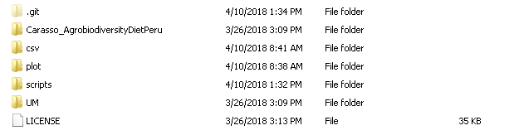

OUTCOMES FOLDERS
csv
outputs in csv format for correlation, fisher and summary. Also, it has the final clusters in csv format (cluster_table.csv)
plot
Graphical outputs

Slide 5
ID | description | type | source
n_species | number of species collected | Numeric | CIAT
n_ecosystems | number of ecosystems where species were collected | Numeric | CIAT
autoconsumption | number of species collected for autoconsumption | Numeric | CIAT
n_preparations | number of food preparations made with collected plants | Numeric | CIAT
n_Agr_pract | number of agricultural practices made with collected plants | Numeric | CIAT
region | landscape (study region): 1 = Huánuco-Quisqui, 2 = Amarilis, 3 = Molino-Umari | factor | UM
headsex | (sex of head of household): 0 = household head is male; 1 = household head is female | logical | UM
elcsa_cat | (categorical Latin American and Caribbean Food Security Scale (ELCSA) score): 0 = food secure; 1 = mildly food insecure; 2 = moderately food insecure; 3 = severely food insecure | factor | UM
edu | edu (education level of index woman): 0 = no education; 1 = incomplete primary; 2 = complete primary; 3 = incomplete secondary; 4 = complete secondary or post-secondary civil | logical | UM
assistance | did the household receive income (in-cash or in-kind) from friends or relatives in the past 12 months?): 0 = no; 1 = yes | factor | UM
nonaginc | (does the household have an income source other than agriculture?): 0 = no; 1 = yes | factor | UM
hhsize | (total number of household members) | Numeric | UM
headage | household head is female headage (age of head of household): age in years | Numeric | UM
numchildren | (total number of children aged < 5 in the household) | Numeric | UM
age | (age of index woman): age in years | Numeric | UM
num_emp | (the number of individuals in the household that are employed) | Numeric | UM
area | household agricultural land área (hectars | Numeric | UM
ch | harvested agricultural production (field crops), metric ton | Numeric | UM
ced | earnings from sold agricultural production (field crops), hundreds of $US | Numeric | UM
l_fields | (total number of fields cultivated, managed or owned by the household - taken from Module L) | Numeric | UM
m_fields | (total number of fields cultivated, managed or owned by the household - taken from Module M) | Numeric | UM
cd_field | cd_field (species diversity of field crops): number of different crop species planted in 2016-2017 | Numeric | UM
cd_garden | cd_garden (species diversity of garden crops): number of different crop species planted in garden 2016-2017 | Numeric | UM
cd_tree | cd_tree (species diversity of trees): number of different trees in cultivation during 2016-2017 | Numeric | UM
cd_gardentree | (species diversityof both garden crops and trees combined): | Numeric | UM
clust | Cluster where the record is | Numeric | CIAT
We remove number of species collected for sell, and We remove number of species collected for other uses (Noise)

Slide 6
Results structure (Boxplots)
Boxplot per region folder: Huanuco\plot\region
Boxplot filename:[var_name] _REGION_ [date]
Boxplot per cluster folder (using region) : Huanuco\plot\full
Boxplot filename:[var_name] _ [date]
Boxplot per cluster folder (without region as variable) : Huanuco\plot\region
Boxplot filename:[var_name] _ [date]

Slide 7
Results structure (Cluster graphics)
folder: Huanuco\plot\cluster
Elbow graphics: WSS_plot_[]_[date]
Height barplots: barplotGraph_[]_[date]
Silhouette graphics: silhouette_[]_[date]
Dendogram: dendogram_[]_[date]

Slide 8
Results structure (Description graphics)
folder: Huanuco\plot\description
Correlation plot for quantitative variables: graphics: corrplot_[]_[date]
Heatmaps for qualitative variables: : heatmap_fisher_[]_[date]
(black: Fisher p values ≤ 0.05, gray: Fisher p values > 0.05)

Slide 9
Results structure (csv files)
folder: Huanuco\csv\results
SUMMARY.xls: summary file with all the important results for the analysis.

Slide 10
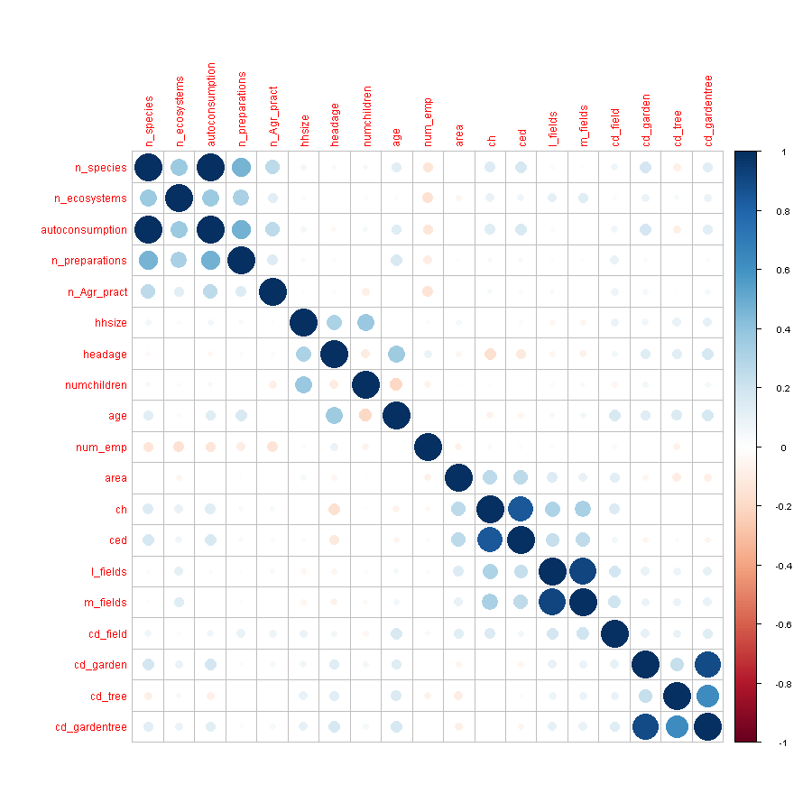
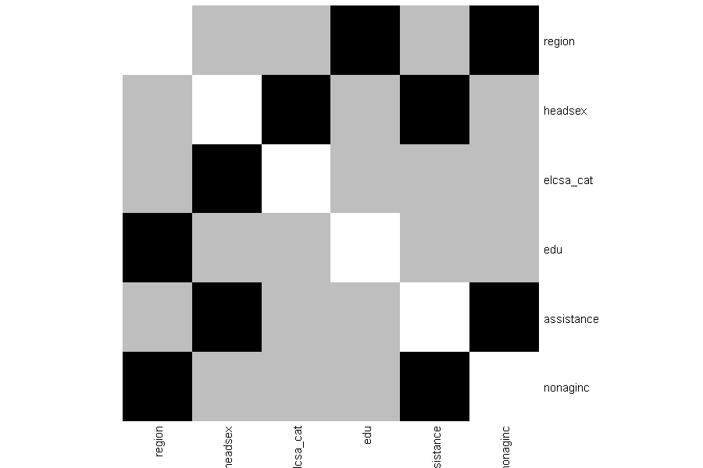
No enough strong correlations to use multivariate approaches
Region, headsex ,elcsa categories, education level have interesting relationship each others ( black)

Slide 11
Dendogram
Cluster | Number of individues
1 | 112
2 | 106
3 | 121

Slide 12
Dendogram without region
Cluster | Number of individues
1 | 115
2 | 66
3 | 158

Slide 13
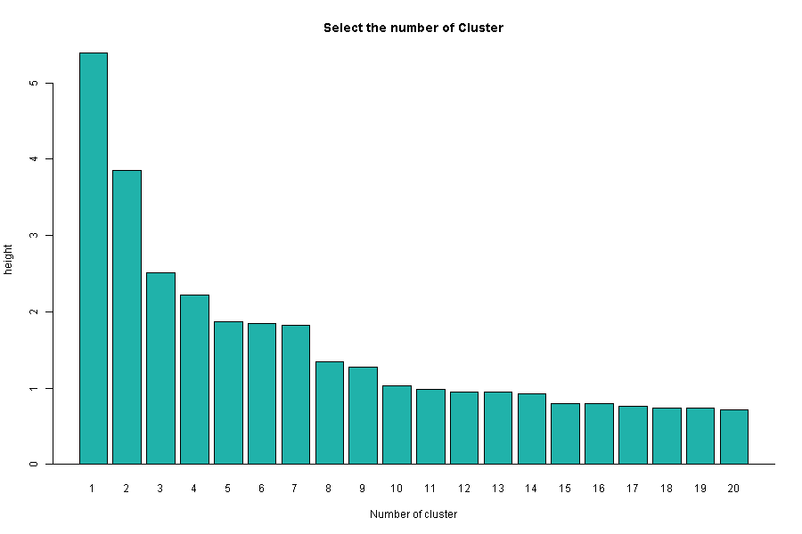
3 clusters suggested
Height criteria
Elbox criteria

Slide 14
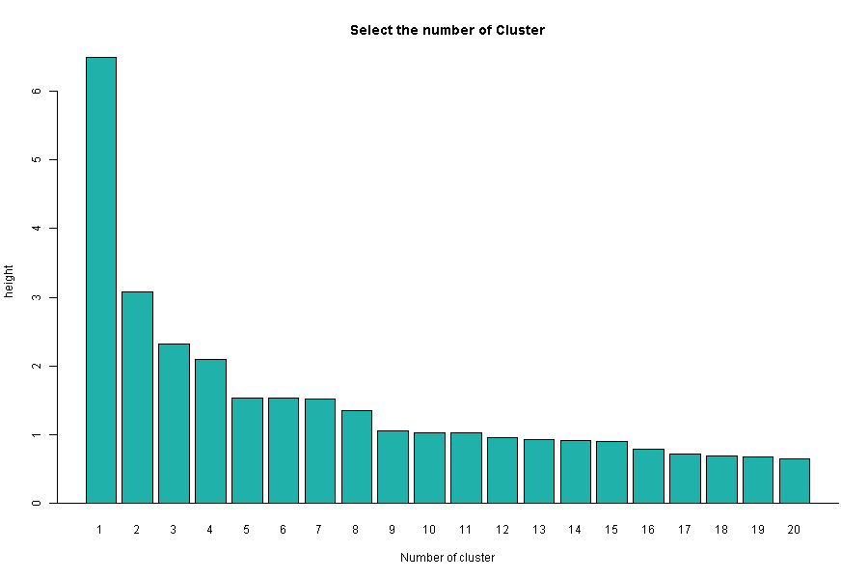
3 clusters suggested without region as variable
Height criteria
Elbox criteria

Slide 15
Example: Number of ecosystem where species were collected
Using region as variable
Without region as variable

Slide 16
Number of ecosystem where species were collected per region(NO CLUSTER)
Without region as variable

